Slide 1
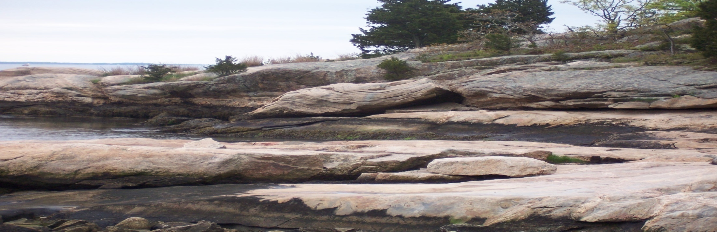
EARTH SCIENCE
SUMMER ASSIGNMENT

Slide 2
Greetings!
My name is Ms. Boucher and I want to welcome you to Enfield High School and to Earth Science.
Our first topic this year will be Geology. During the course of the school year we will also be learning about Meteorology, Astronomy, and Oceanography.
Over the summer you will be required to read a book on an Earth Scientist from the list provided. You will fill out the outline sheet(included in this presentation) for the Earth Scientist as you read. This outline will be submitted to me on the first day of school. This will be the first grade of the quarter.

Slide 3
You will use this outline sheet to create a power point presentation on the scientist of your choice and then present this to your class.
If you do not know how to create a power point presentation don’t worry, we will teach you.
We will have three classes on power point training before you begin working on your power point presentation.
You will also be required to complete the summer activity packet on Math and Reading for the first week of school. This will count as your second grade of the quarter. This packet is designed to get you ready for the first assessment test the second week of school. Please practice.

Slide 4
This summer you will be involved in numerous activities to keep you fit. This summer assignment will help keep your brain fit and in shape for the fall.
Have a great summer!
Ms. Boucher
Science Department Chairperson
Earth Science

Slide 5
Earth Scientists
Robert T. Baker
Mary Anning
Luna Leopold
Clarence Edward Dutton
Richard Leakey
Charles Lyell
Harry Hess
Alfred Wegner
James Hutton
Jacques Cousteau
George Curvier
Charles Richter
Georgius Agricola
Nicholas Shackleton
Eduard Suess
Anders Celsius
Fredrich Mohs
Henry Fairfield Osborn
John Wesley Powell
Eugene Shoemaker
Sally Ride
David Levy
Margret Higgins
Annie Cannon
The Vikings
Robert Ballard
James Cook
Ben Franklin
John Dalton
William Morris Davis
Gabriel Fahrenheit
Jim Cantore

Slide 6
If there is another Earth Scientist that you would like to read about and create a power point presentation, make sure that their body of work is appropriate for the intended field of study.
Make sure you can find enough information to complete the outline sheet.

Slide 7
OUTLINE SHEET
Name of student ______________________________ Date _____________________________
Name of Earth Scientist __________________________________________________________
Year of birth _________________________ Year of Death ___________________________
Parents _____________________________________________________________________
Siblings :____________________________________________________________________
Where he/she was born ______________________________________________________
What was he/she like as a child _______________________________________________
___________________________________________________________________________________________________________________________________________________________________________________________________________________________________________________________________________________________________________________________________________________________________________________________________________________________________________________
Was he/she a loner, social ,what did he/she like to do in their spare time? _________________________
________________________________________________________________________________________________________________________________________________________________________________________________________________________________________________________________________________________________________________________________________________________________________________________

Slide 8
Schooling as a child? ____________________________________________________________________________________________________________________________________________________________________________________________________________________________________________________________________
Did he/she like to collect objects or build things ? Explain_________________________________
____________________________________________________________________________________________________________________________________________________________________________________________________________________________________________________________________________________________________________________________________________________________
Was he/she a good student why or why not?_______________________________________________
_____________________________________________________________________________________________________________________________________________________________________________________________________________________________________________________________________
Did he or she go onto higher education (university)? Where? Did they do well why or why not?______
______________________________________________________________________________________________________________________________________________________________________________________________________________________________________________________________________________________________________________________________________________________________________________________________________________________________________________________________________________________________________________________________________________________________________________________________________________________________________________________________________________________________________________________________________________________________________________________________________________________________________________________________________________________________________

Slide 9
Did he/she have a mentor? (Someone who they looked up to ) Who was their Mentor ?____________
_____________________________________________________________________________________________________________________________________________________________________________________________________________________________________________________________________
How did this Mentor help this person?____________________________________________________
_____________________________________________________________________________________________________________________________________________________________________________________________________________________________________________________________________
Did he or she get married? Have children? What are their name?_____________________________
_____________________________________________________________________________________________________________________________________________________________________________________________________________________________________________________________________
What did he or she study in Earth Science?________________________________________________
_____________________________________________________________________________________
_____________________________________________________________________________________________________________________________________________________________________________

Slide 10
What did he or she discover?_________________________________________________________
___________________________________________________________________________________________________________________________________________________________________________________________________________________________________________________________________________________________________________________________________________________________________________________________________________________________________________________
How was this accepted by
A. The Church ( if applicable)__________________________________________________________
______________________________________________________________________________________________________________________________________________________________________________
B. The scientific community?____________________________________________________________
____________________________________________________________________________________________________________________________________________________________________________________________________________________________________________________________________________________________________________________________________________________________
C. The public __________________________________________________________________________
_____________________________________________________________________________________

Slide 11
Was he or she able to get funding to continue their work?____________________________________
____________________________________________________________________________________
Who backed them with the funding?_________________________________________________
_________________________________________________________________________________
Why was their work so significant to the field of Earth Science?______________________________
________________________________________________________________________________________________________________________________________________________________________________________________________________________________________________________________________________________________________________________________________________________________________________________________________________________________________________________________________________________________________________________________________________________________________________________________________________________________
How did you feel about this scientist?_________________________________________________
____________________________________________________________________________________________________________________________________________________________________________________________________________________________________________________________________________________________________________________________________________________________

Slide 12
ACTIVITY PACKET
Student Name _______________________________________
MATH
MAKING GRAPHS
Katherine and Alberto placed a thermometer in a sunny place and recorded t. Using the findings from their recordings, the temperature every hour throughout the day. Using their findings from their recordings, draw a line graph to show the temperature change.
Findings: 8 a.m. 12 degrees C, 10:00 a.m. 18 degrees C , noon 20 degrees C, 2 pm 27 degrees C,
4 pm 21 degrees C, 6 pm 19 degrees C
How much temperature change is there during the day?

Slide 13
Graph Title:
TEMPERATURE
TIME

Slide 14
Bar Graphs
How much precipitation was there this week? Ryan and Alice made a rain gauge with an old soda bottle . Draw a bar graph to show their results.
See Next Page

Slide 15
On Monday, the rain gauge was filled to the 1-cm mark. They dumped out the water after they recorded their findings. Tuesday, Wednesday and Thursday night, they checked their rain gauge and found that the water had reached between 4 cm and 5 cm marks. On Saturday , the water reached the 2 cm mark. There was no water in the rain gauge on Sunday.
Mon | Tue | Wed | Thur | Fri | Sat | Sun

Slide 16
Is This a Good Experiment?
Answer the following:
1. Sam and Noni were interested in colors. They decided to conduct an experiment to see if different colors moved at different rates. They used a black pen and made a mark in the middle of a paper towel. They set the towel on a plate and dropped four drops of water on the ink mark. They noticed
that the colors separated and spread out on the paper towel. After four minutes, the colors stopped spreading out. They observed that the ink had made rings with the darker colors on the outside of the circle. Is this a good experiment? Why or why not?_____________________________________
____________________________________________________________________________________________________________________________________________________________________________________________________________________________________________________________________________________________________________________________________________________________________________________________________________________________________________________________________________________________________________________________________________
2. Miguel was interested in how different materials soaked up water. He looked inside his mother’s scrap material bag and found lots of different kinds of fabric. They came in all kinds of shapes and sizes. He tacked the different fabrics on a board and hung the board over a basin of water so that they were hanging in the water at different points. It was interesting to see how the water crept up all the different fabrics.

Slide 17
Is this a good experiment? Why or Why not?_______________________________________________
___________________________________________________________________________________________________________________________________________________________________________________________________________________________________________________________________________________________________________________________________________________________________________________________________________________________________________________
Latrice and Frank knew about corrosion, the process by which different metals break down.
They wanted to know if copper or silver corroded faster. They put a penny in a glass of lemon juice and a dia. They plan to see which coin corrodes the most after a week. Is this a good experiment? Why or Why not?__________________________________________________________________
____________________________________________________________________________________________________________________________________________________________________________________________________________________________________________________________________
Try this experiment to see how well the same kind of plant grows in different soil:
Fill the first pot with soil. Fill the second pot with equal parts of soil and powdered clay. Fill the third pot with equal parts soil and sand

Slide 18
Use a pencil to make three small holes in the soil of each pot. Drop a bean into each hole in the soil of the pot. Label the pots.
Place the pots in different parts of the house, and water them every day.
When the seedlings start to grow, measure their height, count the number of leaves and look at
their color.
Is this a good experiment Why or Why not?_______________________________________________
_______________________________________________________________________________________________________________________________________________________________________________________________________________________________________________________________________
Trinh wanted to know if sand or gravel filtered water better. She put 250 g of sand in one filter, and 250 g in another. She then poured dirty water over the filters. She decided the sand filter got the water cleaner. Was this a good experiment? Why or Why not? __________________________________
_______________________________________________________________________________________________________________________________________________________________________________________________________________________________________________________________________

Slide 19
THE SUN: Write a short essay to answer the following question. Every morning , the sun rises , giving us heat and light. Look outside at the morning sky, and you will see that it rises each day in the East. At noon, it is overhead, and then it appears to fall into the West as it follows its daily route. The ancient Greeks believe d they were seeing the Sun god Apollo drive his chariot in the sky . We know understand that the Sun doesn’t really move in the sky. It is the Earth, not the Sun, that is moving.

Slide 20
ESSAY.
Explain what would happen if the Sun burned out. Be sure to include specific details about what would happen and why________________________________________________________________________
___________________________________________________________________________________________________________________________________________________________________________________________________________________________________________________________________________________________________________________________________________________________________________________________________________________________________________________________________________________________________________________________________________________________________________________________________________________________________________________________________________________________________________________________
Describe what causes day and night._______________________________________________________
_____________________________________________________________________________________________________________________________________________________________________________________________________________________________________________________________________
Describe what keeps the Earth from crashing into the Sun.___________________________________
__________________________________________________________________________________________________________________________________________________________________________________________________________________________________________________________________

Slide 21
SCIENCE VOCABULARY
Survey:
Some of the vocabulary you should know other terms may be new. Please define as many as you can in your own words.
1. constant _____________________________________________________________________
2. independent variable __________________________________________________________
3. control ______________________________________________________________________
4. dependent variable _________________________________________________________
5. SI unit _____________________________________________________________________
6. meter _____________________________________________________________________
7. gram __________________________________________________________________
8. volume _______________________________________________________________
9. liter ________________________________________________________________________
10. Scientific method _____________________________________________________________
11. hypothesis __________________________________________________________________
12. Theory ___________________________________________________________________

Slide 22
14. law _____________________________________________________________________________
15. Science_______________________________________________________________________
16. Technology _____________________________________________________________________
17. Astronomy ______________________________________________________________________
18. Geology ________________________________________________________________________
19. Meteorology _________________________________________________________________
20. Oceanography_________________________________________________________________
21. density ______________________________________________________________________
22. mass ________________________________________________________________________
23. weight ______________________________________________________________________

Slide 23
METRIC CONVERSION
Answer the following:
1. The basic unit of length is ___________________
A. gram b. meter c. liter d. Celsius
2. The basic unit of volume is
A. gram b. meter c. liter d. Celsius
3. The basic unit of mass is
A. liter b. meter c. liter d. Celsius
4. mm refers to ________________________
5. cl refers to ___________________________
6. kg refers to _________________________
7. How many centimeters are in one meter?______________________

Slide 24
METRIC CONVERSION
6. How many cg are in hg?_____________________________________
7. 234.6 m = ___________________ km
8. 78g= ______________________mg
9. 0.45ml = ______________________l
Density
Formula: D=M/V
10. You have a rock with a volume of 15 cm 3 and a mass of 45 g . What is its density?
11. What is the density of a piece of iron that has a mass of 59.8g and a volume of 2.08 cm 3?

Slide 25
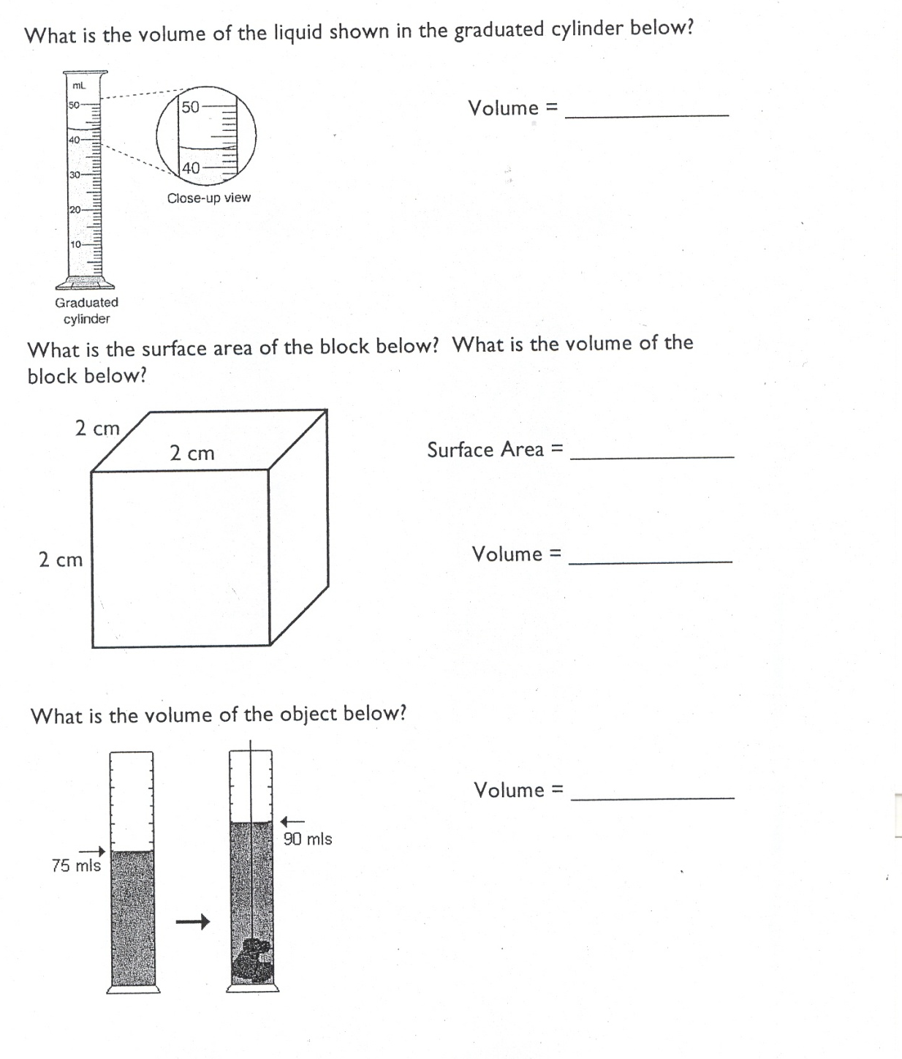

Slide 26
